Slide 1
Project Plans
Senior Design Team 25 (May 2020)

Slide 2
Key Technical Goals
Complete a comprehensive design document
Baseline system architecture implementation
Develop test scenarios
Algorithms developed
Algorithm testing

Slide 3
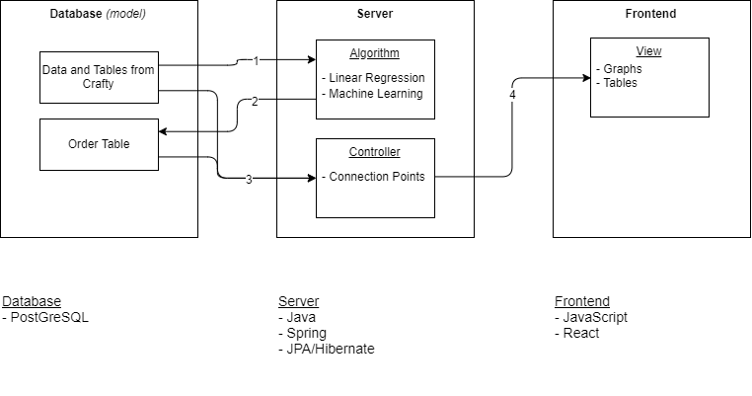
System Sketch

Slide 4
Timeline - Planning
30 Sep.
Finalize project plans and architecture
31 Oct.
Define constraints and the impact on the design decisions
30 Nov.
Finalize methodology selection and tools

Slide 5
Timeline - Development
31 Jan.
Define testing framework and re-evaluate design decisions
29 Feb.
Complete Alpha version of the software
31 Mar.
Finalize Unit testing and validation
30 Apr.
Completion of integration testing and report

